Slide 1
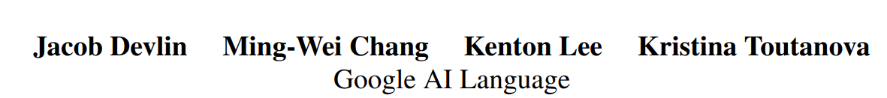
BERT : Pre-training of Deep Bidirectional Transformers for Language Understanding
NAACL 2019, 70000+ citation

Slide 2
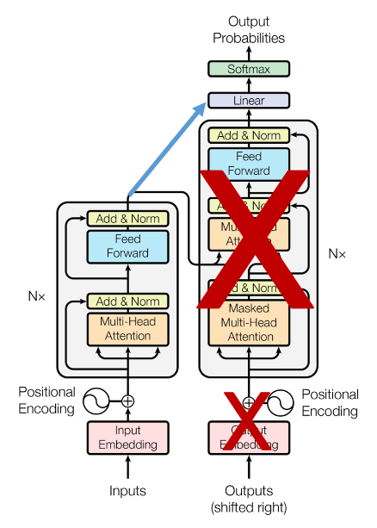


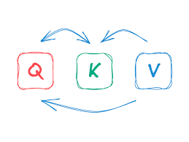
BERT
Bidirectional Encoder Representations from Transformer
Self-attention

Slide 3
BERT
Goal.
1. Getting good performance pre-trained language representation
2. Easy fine-tuning with down-stream tasks

Slide 4
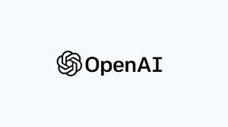
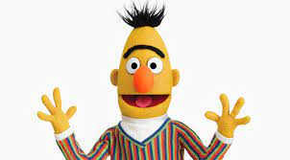
VS GPT
BERT
VS
GPT

Slide 5
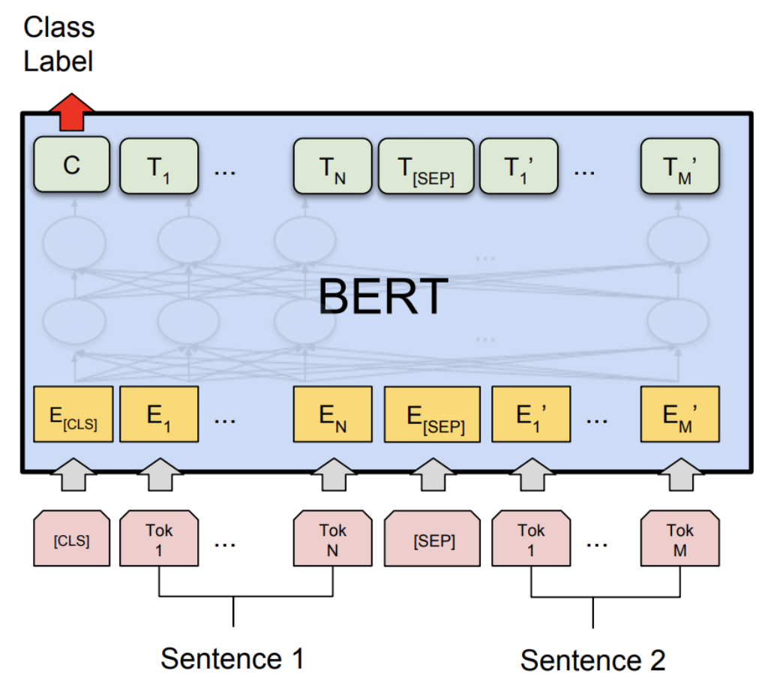
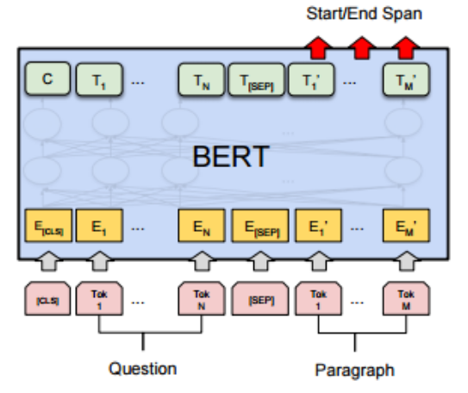
Method
2. Fine-Tuning
1. Pre-training
for QA task

Slide 6

Method
2. Fine-Tuning
1. Pre-training
for QA task

Slide 7
Pre-training
Transformer Encoder

Slide 8
Pre-training
Transformer Encoder
Special classification token
Separate token

Slide 9
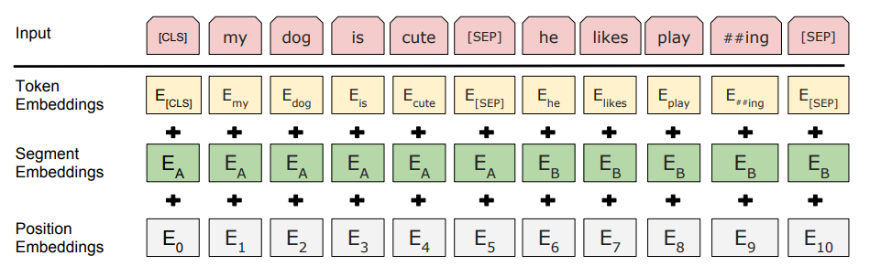
Pre-training
Sentence 1
Sentence 2
Token embedding : token meaning
Segment embedding : which sentence the token belongs to
Position embedding : location information

Slide 10
Pre-training
Self-attention
It can be seen in both directions
Transformer Encoder
I a student
?

Slide 11
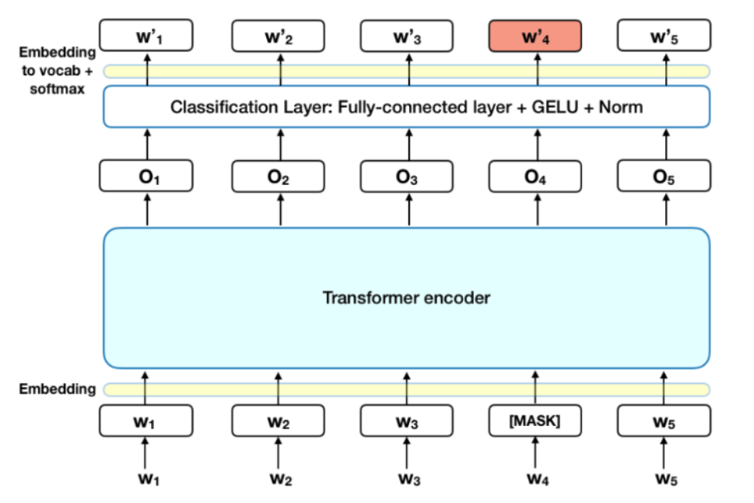
Pre-training
Transformer Encoder

Slide 12
Pre-training
The ability to learn
Next sentence prediction
Predict what masked token is
Transformer Encoder

Slide 13
Pre-training
How?
[CLS] token loot at sentence 1 & 2 using self-attention
Predict next sentence
Transformer Encoder

Slide 14
Pre-training
How?
[MASK] token loot at sentence using self-attention
Predict masked token

Slide 15
Method
1. Pre-training
Next sentence prediction : consider/understand the relationship between sentences
Masked token prediction: Relationships within a single sentence

Slide 16
Method
2. Fine-Tuning
1. Pre-training
for QA task

Slide 17
Fine-Tuning
for QA task
How?
Look for start/end span after [sep] token
Sentence 1
Sentence 2

Slide 18
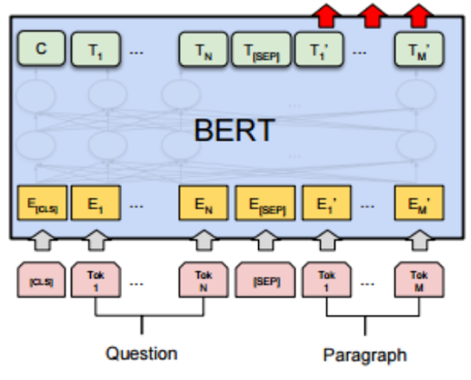
Fine-Tuning
for QA task
Softmax
How?
Start vector S
End vector E
Start vector
End vector

Slide 19
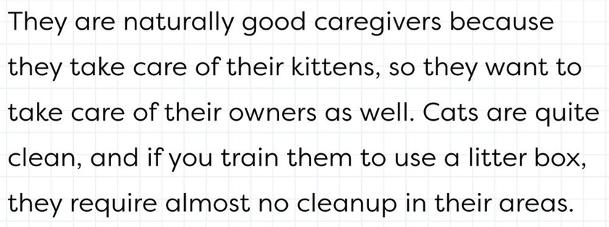
Fine-Tuning
for QA task
How?
In other words, find the start and end points in the paragraph
Start
End
<Paragraph>

Slide 20
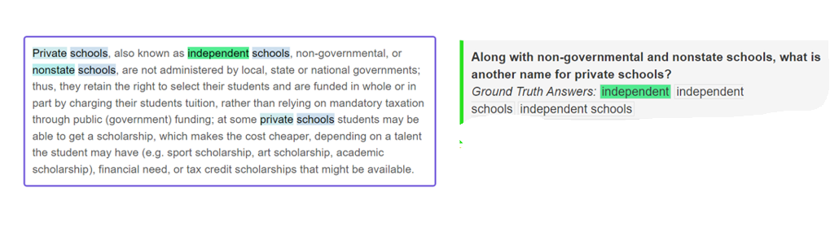
Experiment
SQuAD dataset
Question
Answer
Content

Slide 21
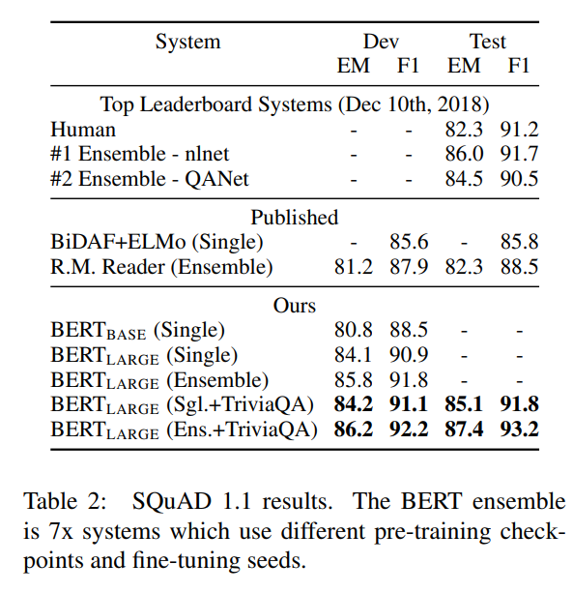
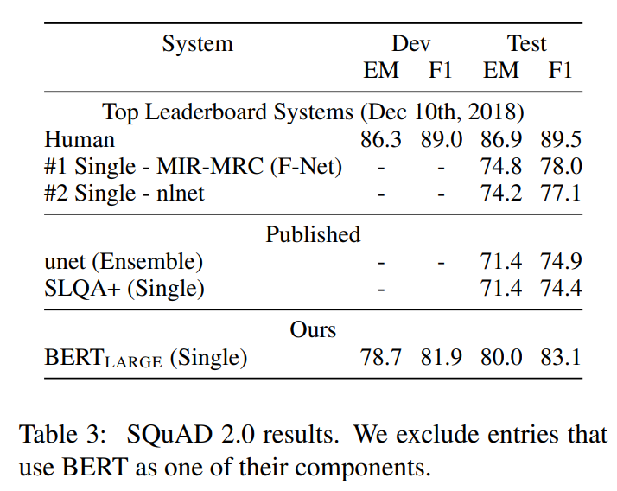
Experiment

Slide 22
VS GPT
BERT
VS
GPT

Slide 23

2018
2019
2020
GPT-1
BERT
GPT-3

Slide 24
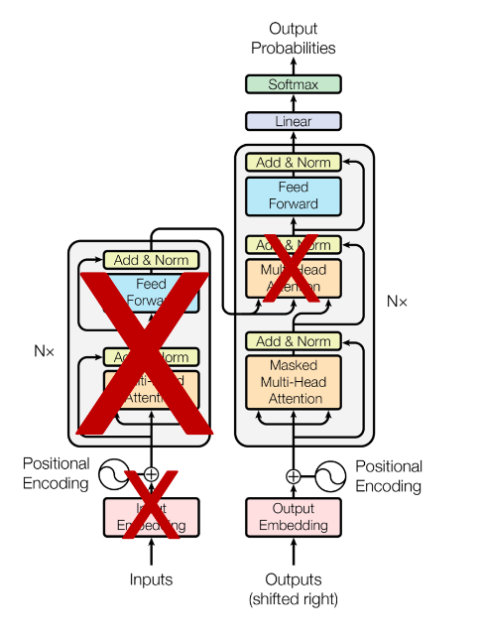
VS GPT
GPT
BERT

Slide 25
VS GPT
GPT
Only next token prediction (Language model)
Unidirectional model
BERT
Masked token prediction (Masked language model)
Next sentence prediction
Bidirectional model
I am a
?
I a student
?

Slide 26
Conclusion
VS GPT
GPT only puts one sentence as input when pre-training
Relationship between sentences is not learned in the pre-training stage
In the case of QA, context is important, but learning about these tasks is less
“GPT is unidirectional”

Slide 27
Conclusion
BERT
Masked token prediction: Relationships within a single sentence
Next sentence prediction : consider/understand the relationship between sentences
it works better for down-stream tasks because it has increased performance to be used for multiple tasks in the pre-training stage
“BERT is bidirectional”

Slide 28
Thank you

